Slide 1
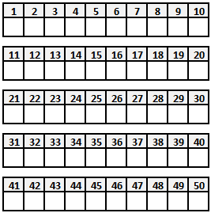
Field Target Score Card
Field Target Score Card
Field Target Score Card
Shooter ID :
Date:
Shooter ID :
Date:
Shooter ID :
Date:
Name:
Name:
Name:
Country:
Country:
Country:
Black
Course
PCP _
Start
Lane
Black
Course
PCP _
Start
Lane
Black
Course
PCP _
Start
Lane
Springer
Springer
Springer
Warnings
1
2
3
Team
Warnings
1
2
3
Team
Warnings
1
2
3
Team
Total
Total
Total
Total
Total
Total
Total
Total
Total
Total
Total
Total
Total
Total
Total
0 - Miss X - Hit
0 - Miss X - Hit
0 - Miss X - Hit
Signatures
Signatures
Signatures
Total
Hits
Total
Hits
Total
Hits
Control Sticker/Stamp/Sig.
Pellet
Velocity:
Control Sticker/Stamp/Sig.
Pellet
Velocity:
Control Sticker/Stamp/Sig.
Pellet
Velocity:
Weight:
Weight:
Weight:

Slide 2
Field Target Score Card
Field Target Score Card
Field Target Score Card
Marshall’s Observations
Marshall’s Observations
Marshall’s Observations

Slide 3
Field Target Score Card
Field Target Score Card
Field Target Score Card
Shooter ID :
Date:
Shooter ID :
Date:
Shooter ID :
Date:
Name:
Name:
Name:
Country:
Country:
Country:
Yellow
Course
PCP _
Start
Lane
Yellow
Course
PCP _
Start
Lane
Yellow
Course
PCP _
Start
Lane
Springer
Springer
Springer
Warnings
1
2
3
Team
Warnings
1
2
3
Team
Warnings
1
2
3
Team
Total
Total
Total
Total
Total
Total
Total
Total
Total
Total
Total
Total
Total
Total
Total
0 - Miss X - Hit
0 - Miss X - Hit
0 - Miss X - Hit
Signatures
Signatures
Signatures
Total
Hits
Total
Hits
Total
Hits
Control Sticker/Stamp/Sig.
Pellet
Velocity:
Control Sticker/Stamp/Sig.
Pellet
Velocity:
Control Sticker/Stamp/Sig.
Pellet
Velocity:
Weight:
Weight:
Weight:

Slide 4
Field Target Score Card
Field Target Score Card
Field Target Score Card
Marshall’s Observations
Marshall’s Observations
Marshall’s Observations

Slide 5
Field Target Score Card
Field Target Score Card
Field Target Score Card
Shooter ID :
Date:
Shooter ID :
Date:
Shooter ID :
Date:
Name:
Name:
Name:
Country:
Country:
Country:
Red
Course
PCP _
Start
Lane
Red
Course
PCP _
Start
Lane
Red
Course
PCP _
Start
Lane
Springer
Springer
Springer
Warnings
1
2
3
Team
Warnings
1
2
3
Team
Warnings
1
2
3
Team
Total
Total
Total
Total
Total
Total
Total
Total
Total
Total
Total
Total
Total
Total
Total
0 - Miss X - Hit
0 - Miss X - Hit
0 - Miss X - Hit
Signatures
Signatures
Signatures
Total
Hits
Total
Hits
Total
Hits
Control Sticker/Stamp/Sig.
Pellet
Velocity:
Control Sticker/Stamp/Sig.
Pellet
Velocity:
Control Sticker/Stamp/Sig.
Pellet
Velocity:
Weight:
Weight:
Weight:

Slide 6
Field Target Score Card
Field Target Score Card
Field Target Score Card
Marshall’s Observations
Marshall’s Observations
Marshall’s Observations

Slide 7
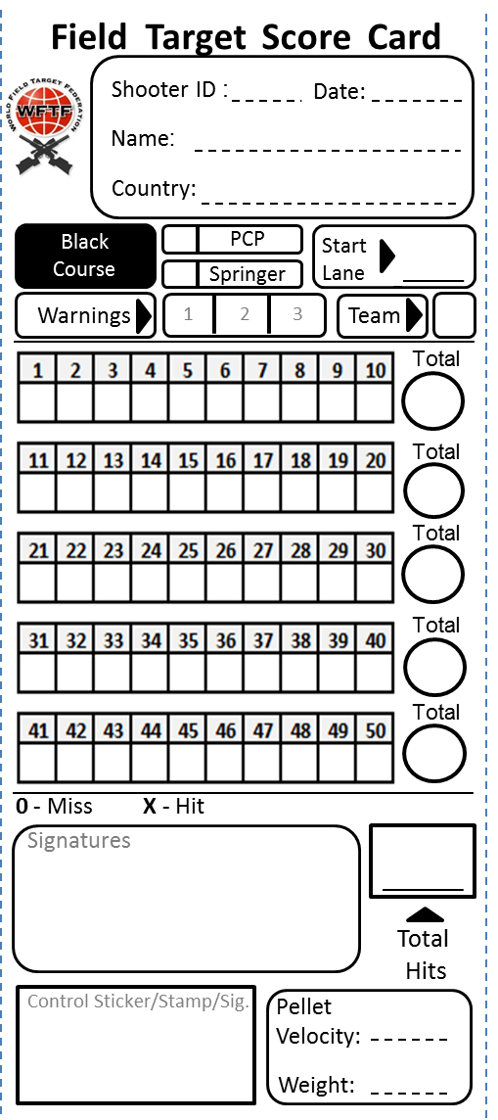
Shooter ID
Space for a organization to identify a shooter.
A Sticker can be used.
Class
Starting Lane
Identification of
the course
Identify if you are a team member
Warnings (new)
Sub-Total
Total Hits
Signatures of
the shooters
Control signature,
sticker or similar
Pellet velocity and weight

